Slide 1
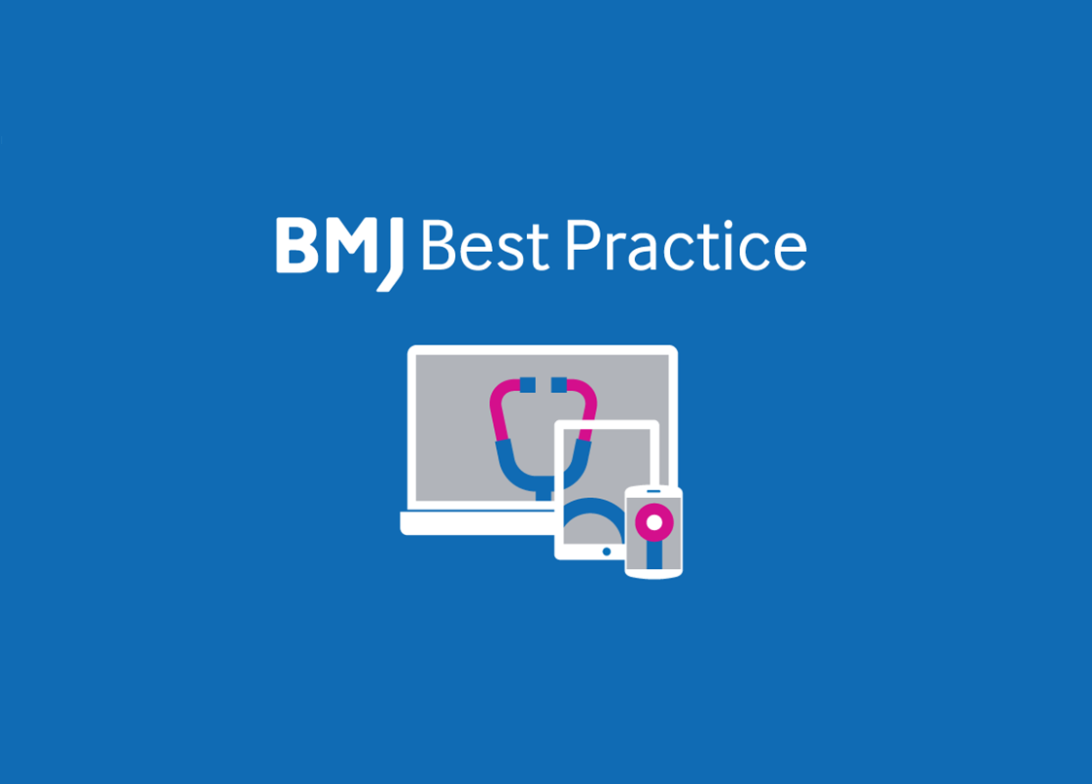
Straight to the point of care
Ali Boukabache | Training Manager, BMJ | aboukabache@bmj.com
Notes:
As a direct result of requests from busy healthcare professionals, Health Education England (HEE) has invested in a national ‘point of care’ tool. BMJ Best Practice is now available to the whole of the NHS workforce in England.

Slide 2
What is BMJ Best Practice?
A clinical decision support tool, uniquely structured around the patient consultation with advice on symptom evaluation, test ordering and treatment approach.
Ranked one of the best clinical decision support tools for health professionals worldwide.*
Scored highest in an independent study of diagnostic decision support tools.**
* JMIR - Providing Doctors With High-Quality Information: An Updated Evaluation of Web-Based Point-of-Care Information Summaries
** Evaluating online diagnostic decision support tools for the clinical setting
Notes:
A POINT OF CARE clinical decision support tool. Designed for use in real life hospital setting. Best Practice is uniquely structured around the patient consultation with advice on symptom evaluation, test ordering and treatment approach.
Best Practice is recognised as one of the best clinical decision support tools for health professionals worldwide. In 2016, BMJ Best Practice was ranked equal first in an independent review of CDS tools for breadth of disease coverage, editorial quality, and evidence-based methodology.
In another independent study of diagnostic decision support tools, BMJ Best Practice scored highest.
http://bestpractice.bmj.com/info/reinvention/

Slide 3
Focusing on what’s important to our users
Speed - being able to find answers quickly
Actionable - Practical information for use at the point of care
Assurance - Trusted clinical evidence, Important updates
Access - able to access easily anywhere, anytime (offline via app)
Notes:
Best Practice is committed to continuous improvement with users at the heart of what they do.
Since 2015 BMJ has carried out extensive research amongst healthcare professionals and customers around the world. This research has steered the development of BMJ Best Practice and every feature you see has been researched, developed and tested thoroughly.
The reinvention has focused on users number one requirement: to find the latest information quickly and easily, whenever and wherever they need it.
http://bestpractice.bmj.com/info/reinvention/

Slide 4
BMJ Best Practice delivers the latest evidence-based information quickly and accurately.
BMJ Best Practice helps you
Be confident in your clinical decisions. Daily research and guidelines searches, using robust methodology and expert opinion to focus on the evidence that matters
Quickly access detailed drug information on dosing, availability, formulations, side effects and contraindications with our integrated formularies
Make joint decision making easier with our accredited, evidence based patient leaflets
Stay current and ensure your ongoing professional development, with automatic CME/CPD tracking to support revalidation and appraisal
Get the right information, whenever and wherever you need it, with online, mobile and offline access via the Best Practice app
Notes:
BMJ Best Practice can help ensure better, safer care with fast access to the latest clinical information.
Best Practice is used by the whole multidisciplinary team. So while it’s ideal for supporting new staff such as junior doctors, it is also used by nurses, and pharmacists. Why? Best Practice has the latest point of care information for over 90% of the most commonly presented conditions in both primary and secondary care settings.
With BMJ Best Practice you can be confident in your clinical decisions, with BMJ’s robust evidence-based methodology.
Best Practice offers direct access to drug monographs on BNF/BNFC, without disturbing your workflow.
Best Practice also makes joint decision making easier, with access to over 400 patient leaflets.
The highly rated BMJ Best practice app is also available to you. This can be used offline, providing you with trusted decision support information in an instant.
Also, as long as you’re in logged into your personal account, or using the app – all search and browse activity is automatically tracked. You can then download CPD/CME certificates of your activity to support revalidation and appraisal

Slide 5
BMJ Best Practice Awards
In 2018, BMJ Best Practice won six prestigious awards thanks to continuous feedback from our users.
Continuing excellence in 2019, BMJ Best Practice won three awards for Reinventing Clinical Decision Support in the ‘General Health’ category and two feature categories - ‘User Experience’ and ‘Best Practices.’
These awards help us to remain one of the number one ranked best clinical decision support tools for healthcare professionals worldwide.
Notes:
Best Practice won several awards. And BMJ continue to engage with their users to ensure continuous improvement.

Slide 6
Two main topic types: Assessment and Condition topics
Notes:
BMJ Best Practice offers a very intuitive navigation. There are two main topic types:
-Assessment topics: and these cover the evaluation of a symptom, sign or laboratory finding and help narrow down the differential diagnosis.
-Condition topics: form the majority of content, and these cover the complete management of conditions. Covering: theory, prevention, diagnosis, treatment, and prognosis

Slide 7
Go to: bestpractice.bmj.com
Notes:
------------
Provide any relevant details of local access methods available to your users e.g.
Access via networked computers
Access via intranet
Access via desktop icon
Note: Access via OpenAthens is not required/will not work if accessing via other methods.
The following slides show access via OpenAthens
------------
You’re able to access BMJ Best Practice via OpenAthens (this is not required if accessing via the above methods).
Visit bestpractice.bmj.com and click “Log in”

Slide 8
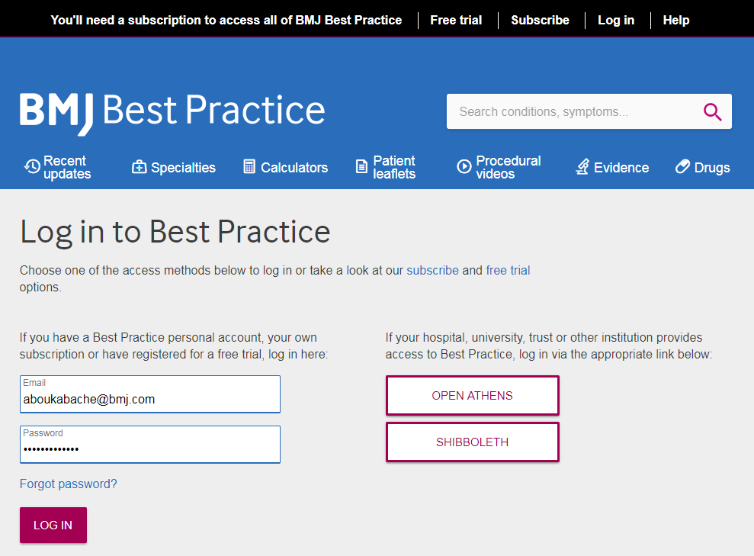
Notes:
You then select “Open Athens”

Slide 9
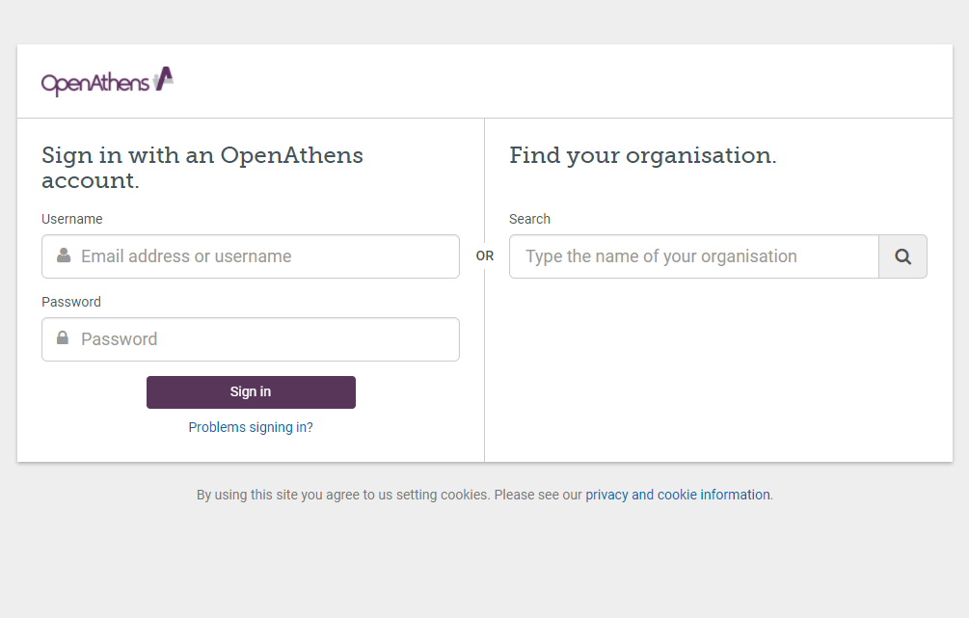
Notes:
You enter the OpenAthens credentials and click “Sign in”

Slide 10
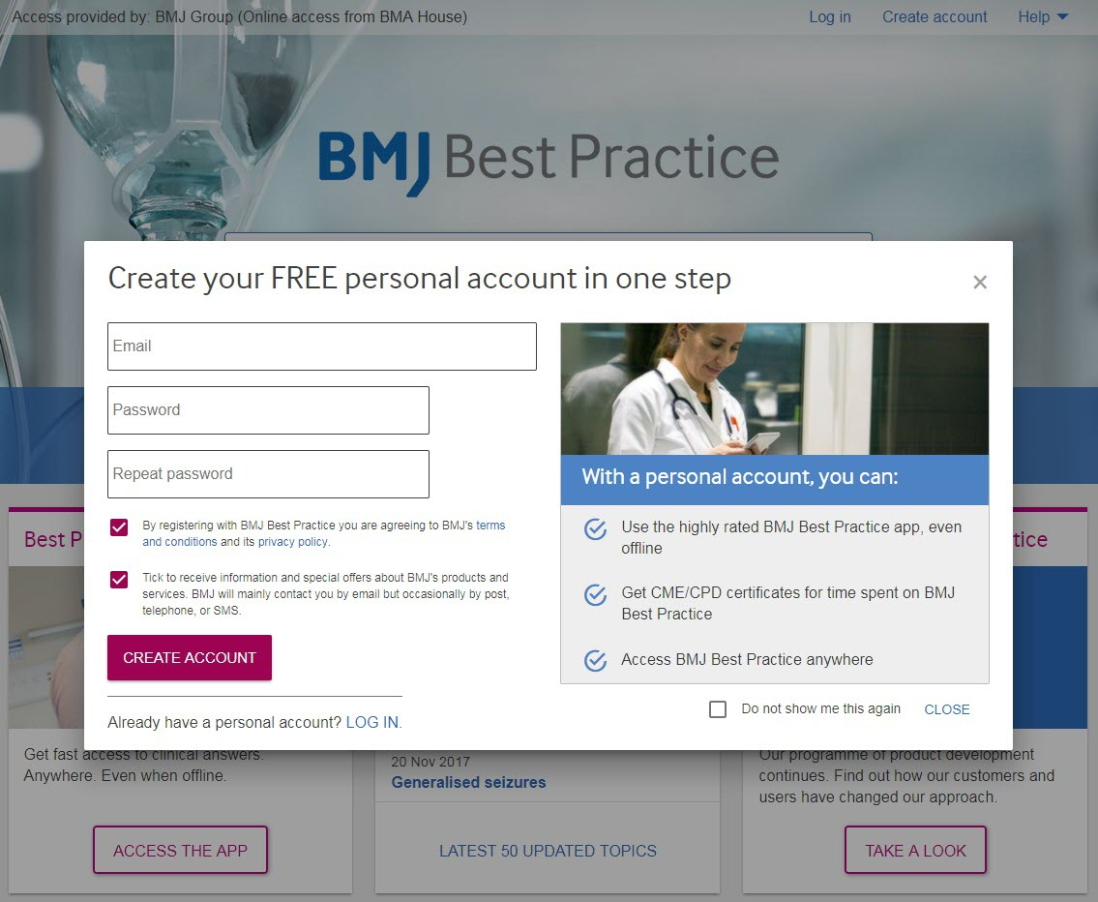
You may also register via this link
Notes:
This will take you back to the Best Practice site.
Here you’ll be prompted to create a personal account (or log in if you already have one). As you can see, this is a very simple process.
A personal account is required to:
Access the highly rated app.
Enable automatic tracking of search and browse activity, so you can create CME/CPD certificates.
Enable the Important Updates flag feature - we’ll show this in a moment

Slide 11
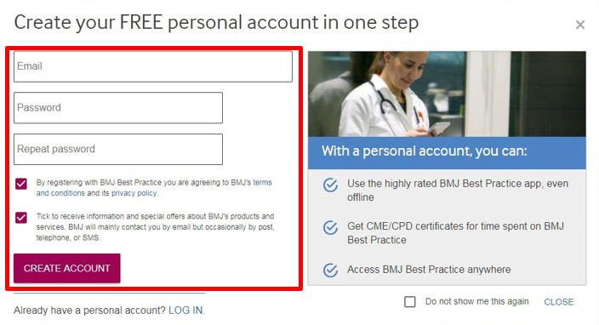
BMJ Best Practice app
Access trusted clinical information anywhere
1. Search “BMJ Best Practice” on OR
2. Download the app
3. Enter your email address and password
Notes:
So now that we’ve created a personal account. We can go to the App store or Google play, search for “BMJ Best Practice”, download it, and log in to it using the personal account created – Not the OpenAthens details.
The app is highly rated, with 4.5 stars on the App store and 4.8 starts on Google play (December 2018)

Slide 12
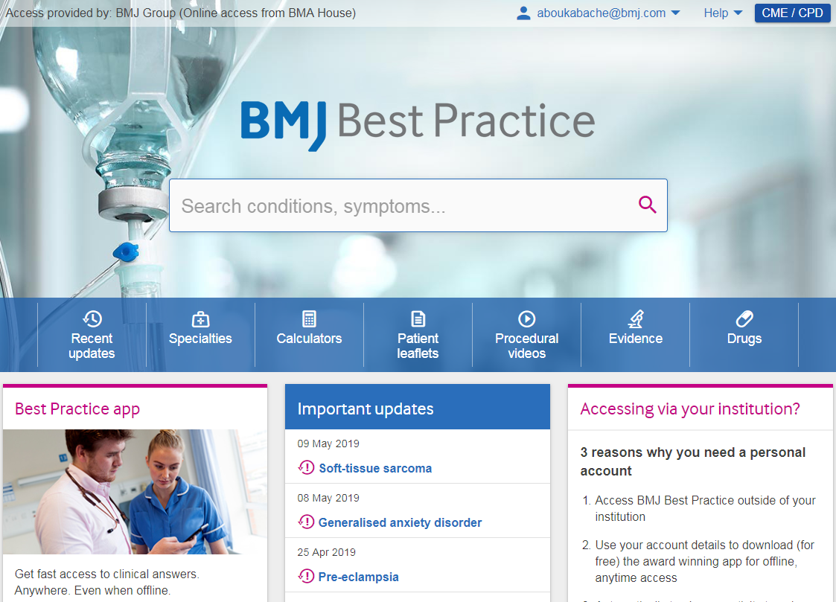
Notes:
This is the BMJ Best Practice homepage. Here, we have a large search box in the middle of the screen to search for conditions or symptoms. As soon as you start typing, auto-suggest steers you to the information you’re searching for.
Below that we have a browse bar, highlighting the wealth of information available.
At the bottom of the screen users can see the most recent Important Updates. Important Updates have significant, potentially practice changing, implications. They will often affect large numbers of patients or be in high risk areas. Key points are summarised so that users can immediately see what’s changed without interrupting their workflow and without having to read through lengthy guidelines.

Slide 13
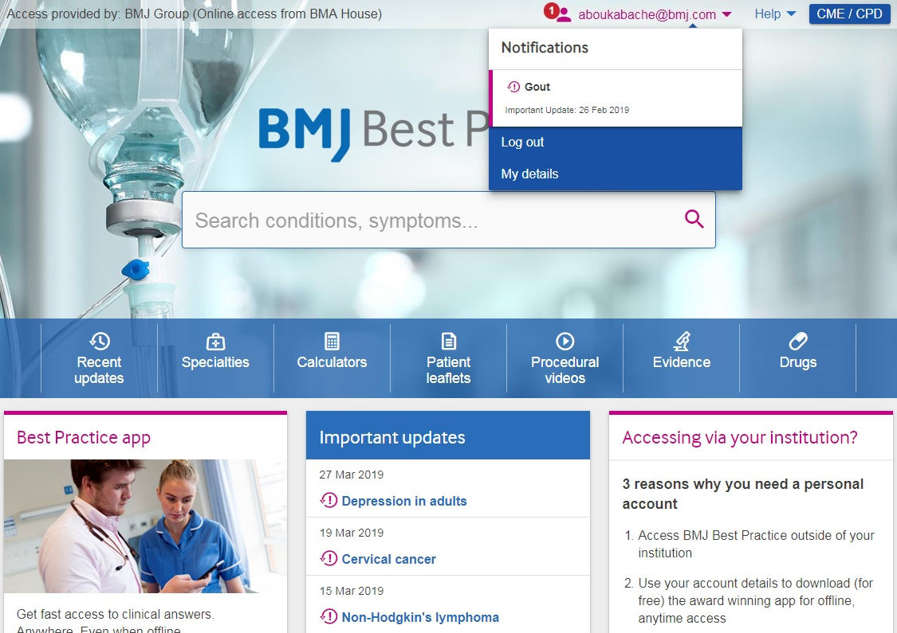
Notes:
There is also a feature on the website which alerts you to Important Updates on topics viewed within the last 6 months (if you have a personal account). This appears as a badge notification next to your email address at the top of the screen - And allows you to quickly update your knowledge on topics relevant to you.

Slide 14
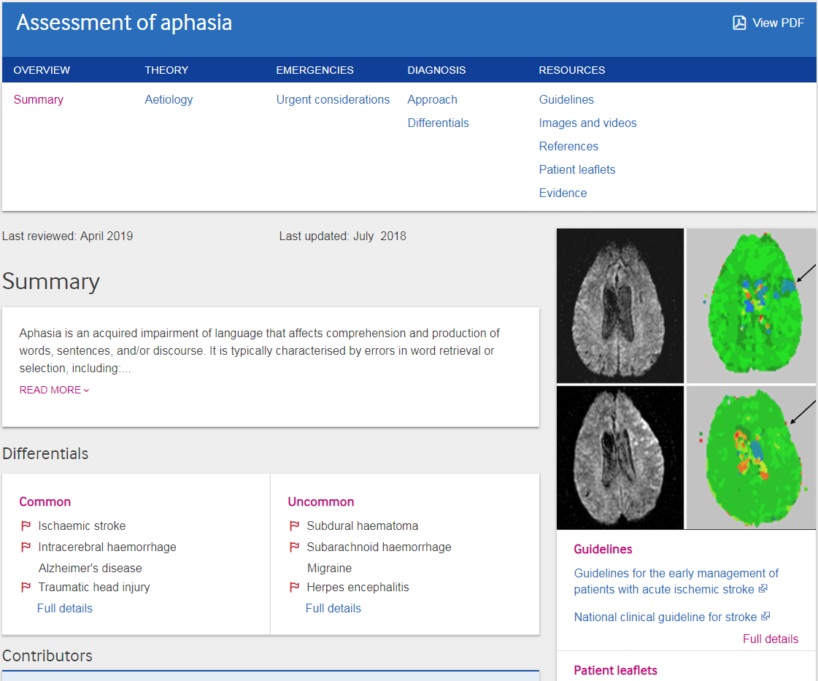
Continuously updated
Notes:
So let’s start by looking at an Assessment topic. As we said earlier these cover the evaluation of a symptom, sign or laboratory finding and help narrow down the differential diagnosis.
Also, Best Practice is continuously updated and all topics have a “last reviewed” and a “last updated” date.
The homepages of topics have a summary as well as highlights of the various sections within a topic.
Assessment topics focus mainly on Diagnosis. However they also have a “Theory” section and an “Emergencies” section with “Urgent considerations”

Slide 15
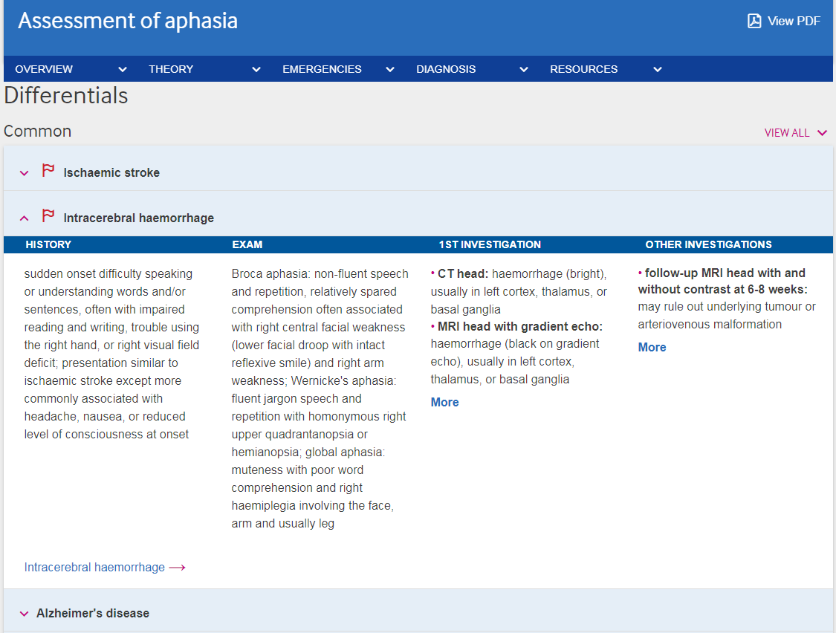
Notes:
Looking at the Differentials section; Here you’ll be able to see a list of differentials at a glance. Which ideal at the point of care. These are listed by frequency.
As displayed on this slide, for each of these differentials, you’re provided with just the right amount of information. That’s the history, exam, and investigations. You’re able to compare between two or more differentials before looking at the full topics via the links provided.

Slide 16
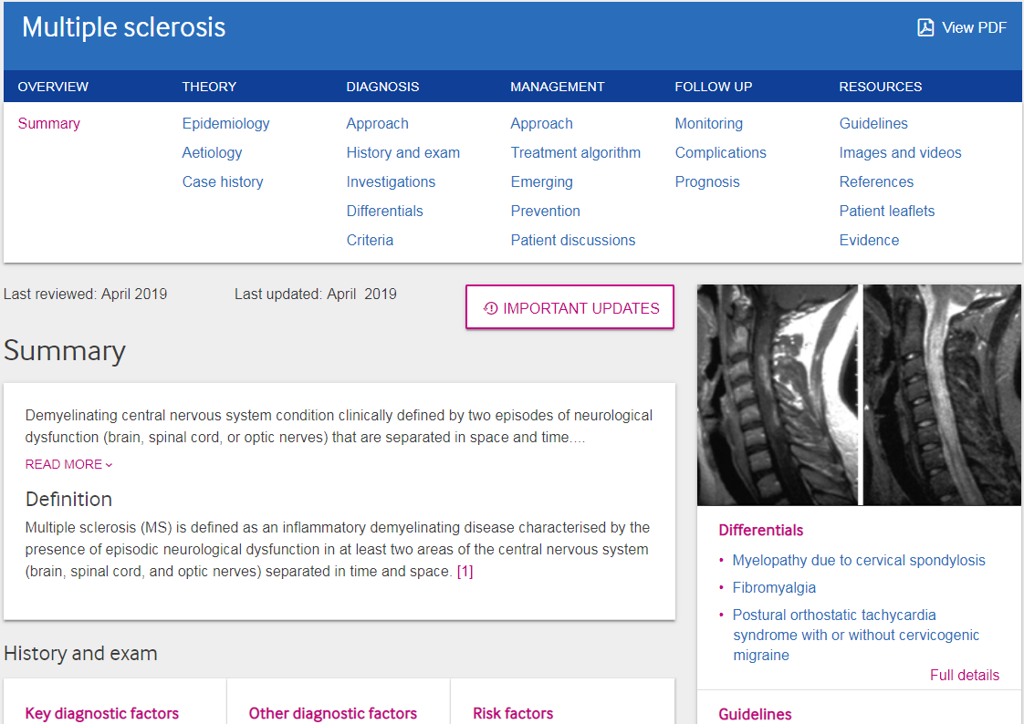
Intuitive and consistent layout for each topic
Unique visual alerts for important changes
Notes:
Information in Best Practice is highly structured with a unique horizontal navigation that follows the clinical workflow. Looking at the headings on this condition topic, you realise that the navigation makes it very easy to access the various sections in the topic.
We mentioned Important Updates earlier; these have been introduced as a direct result of user and customer feedback. You can see here how users are alerted to the Important Updates.
Clicking on the alert reveals a summary of the key points, so users can see exactly what has changed without reading lengthy guidelines. Although a link to the original source of the update is also provided.

Slide 17
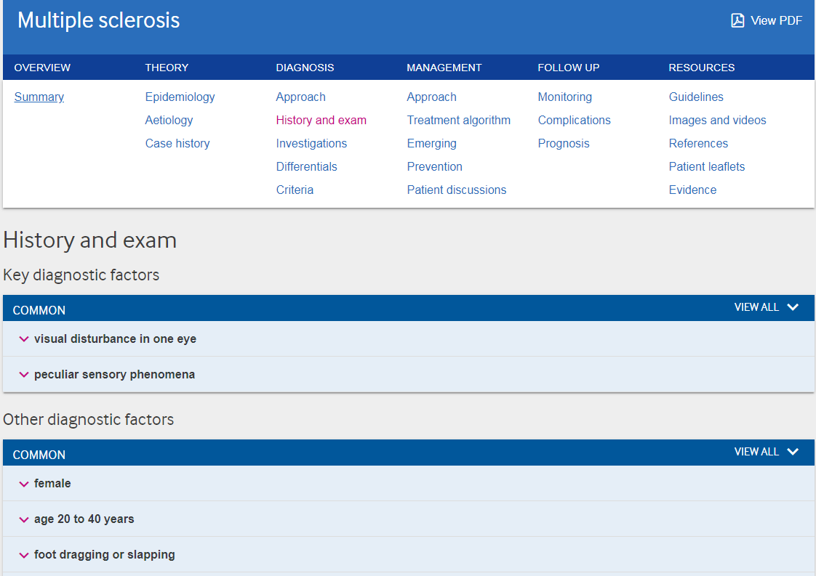
Notes:
At the point of care, you’ll be mainly looking at the “Diagnosis” and “Management” sections. So we’ll look at these.
We’ve clicked on the “History and exam” subheading. Here we have the diagnostic factors. As you can see these are ideally presented as expandable lists. Further down you’ll find the risk factors.

Slide 18
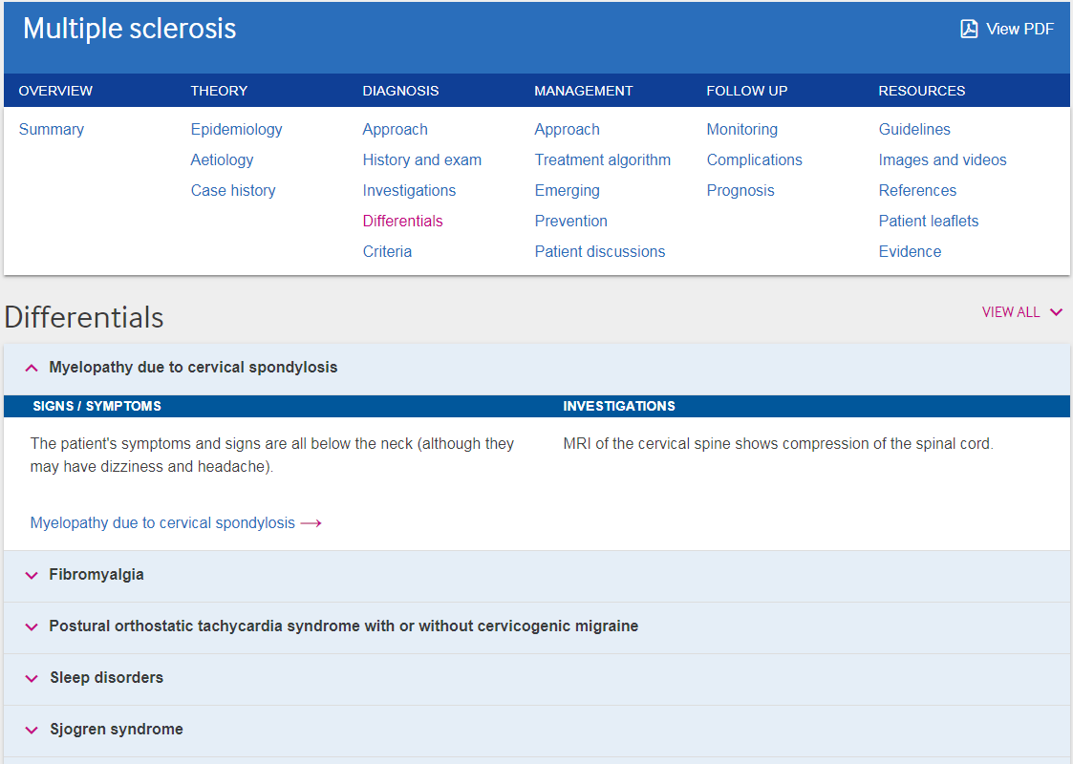
Notes:
The “Differentials” section here is very important as it allows the user to consider other alternatives or rule them out. With a summary of the Signs and Symptoms and Investigations for each differential. As well as a link to the full topic.

Slide 19
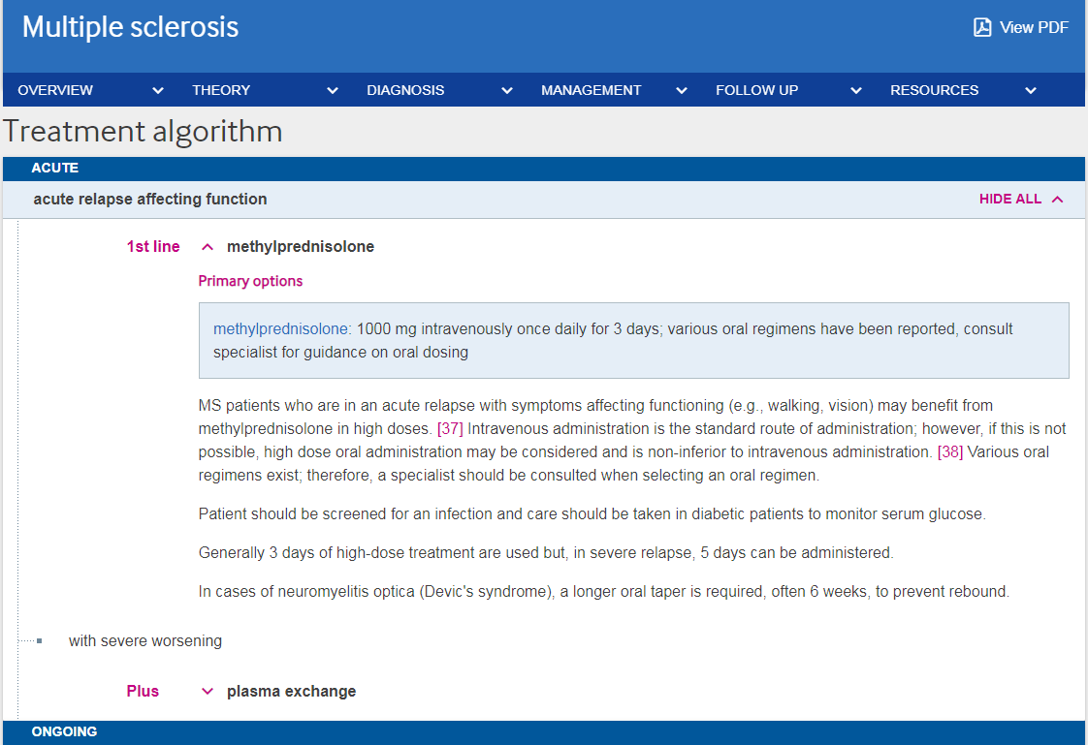
Link to BNF/BNFc monograph
Notes:
We’re now looking at our unique “Treatment algorithms” under “Management”. These are listed by patient group - and are divided into; Presumptive, Acute, and Ongoing (or chronic).
Here you have treatment options and dosages. You’re also able to access the drug monographs for the drugs listed. When you click on a drug name, you’ll have the option to select either BNF or BNFC
You’ll also notice how Cochrane Clinical Answers are integrated. You’ll be presented with CCA icons next to statements. Upon clicking the icon, the question appears. And if you’d like to read the answer, you click “Show me the answer”

Slide 20
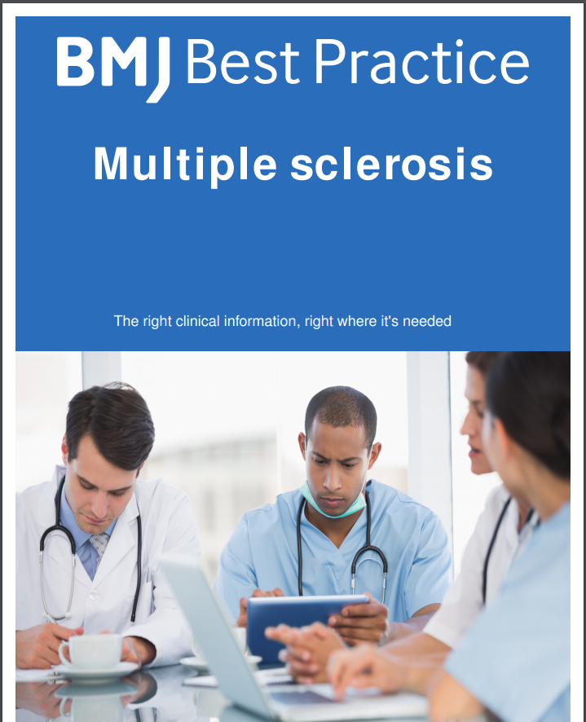
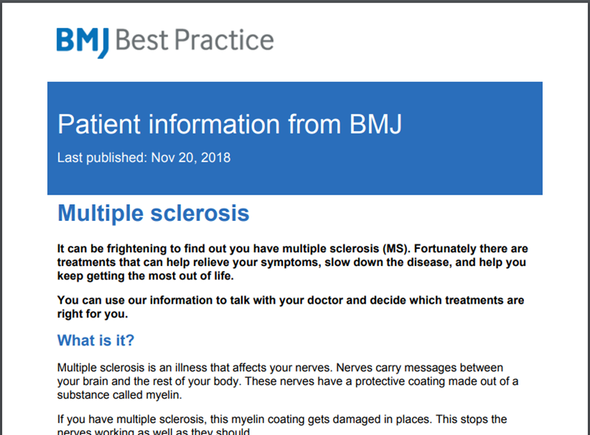
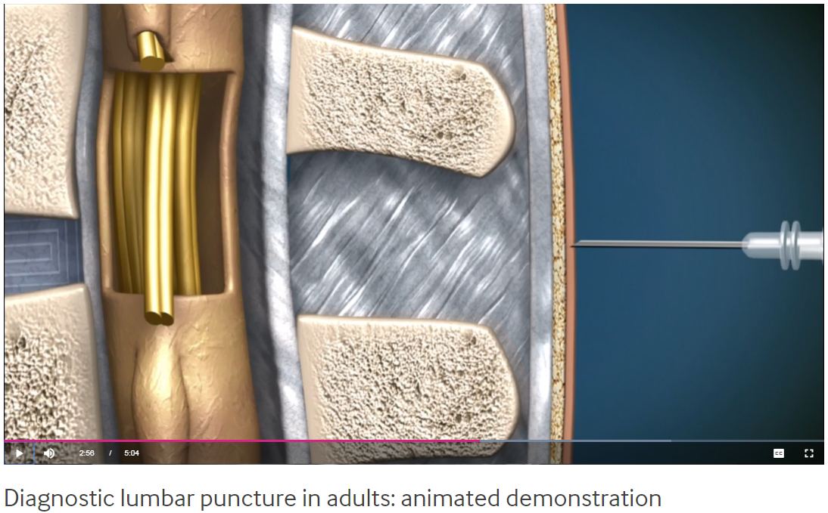
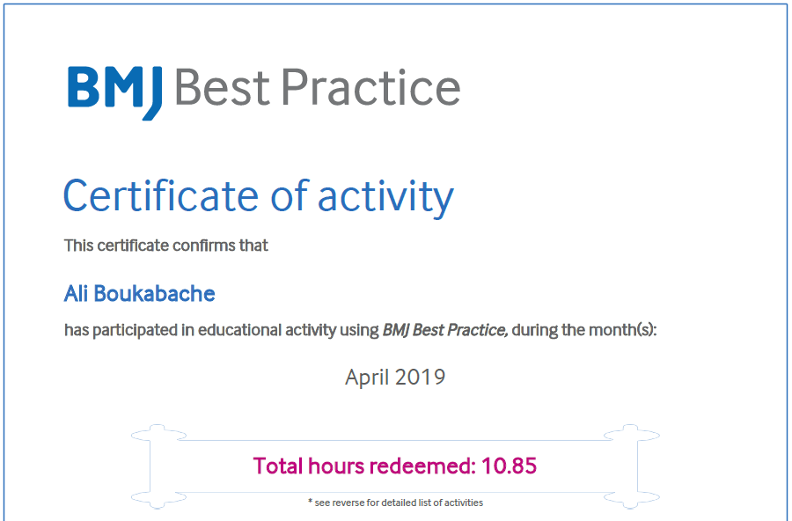
Some popular features
Notes:
Now to some popular features:
Best Practice contains over 400 “patient leaflets”. These mirror the information on the topics. They are written in plain English. They’re accredited by the Information Standard and every leaflet is reviewed by the BMJ patient panel.
The “View PDF” feature allows you to download a PDF of the whole topic.
“Procedural videos” are also very popular. These cover essential clinical techniques. They are short, high quality animations. A list of equipment, contraindications, indications, complications and aftercare is also included.
The CME/CPD feature located on the top right corner of the page will only appear if you are signed into your personal account. It allows you to create certificates of your activity on the website and application.

Slide 21
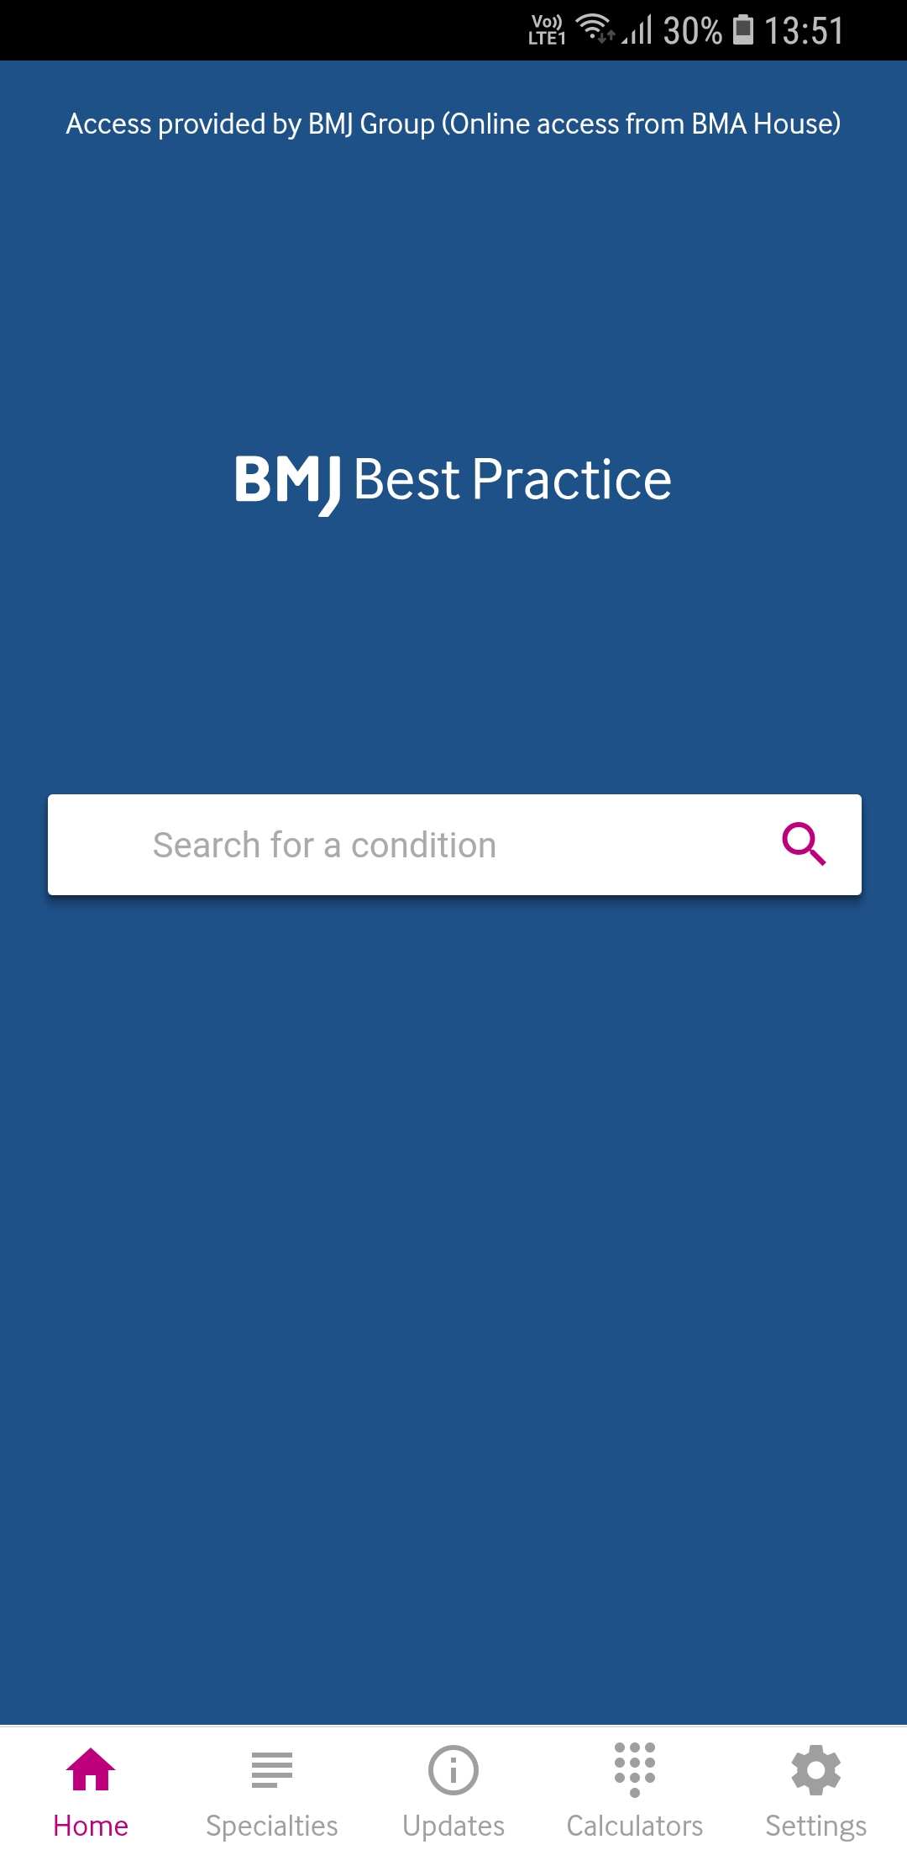
Using the BMJ Best Practice app
Online & Offline Access
Similar to the website, BMJ Best Practice app offers both search and ‘browse’ functionality
Easy to navigate and comprehensive. This app is rapidly becoming the first point of reference for conditions outwith my usual area of practice.
Fabulous resource for busy doctors
Notes:
The application has an intuitive interface. With a search box and browse functionality to browse specialties, view updates, or access the calculators.
And here are a couple of user reviews from the App Store.

Slide 22
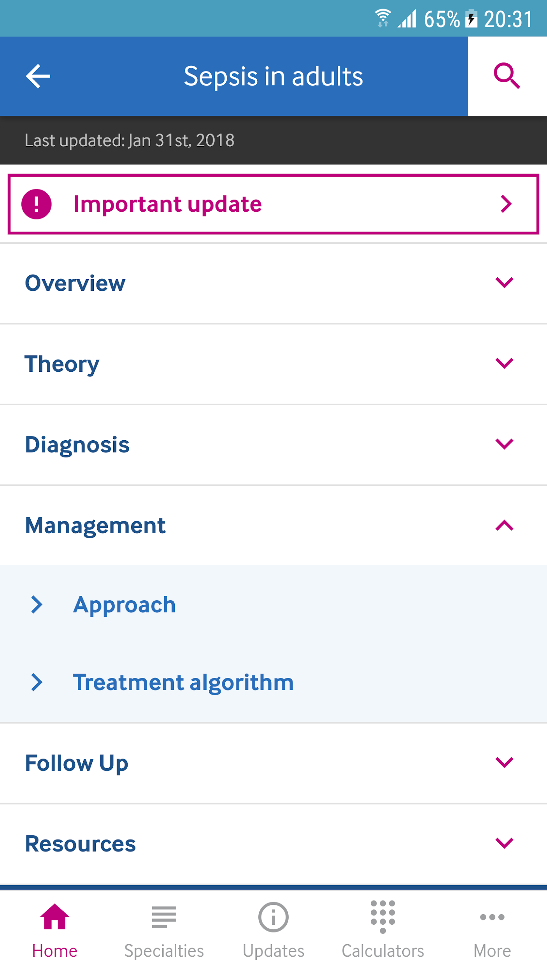
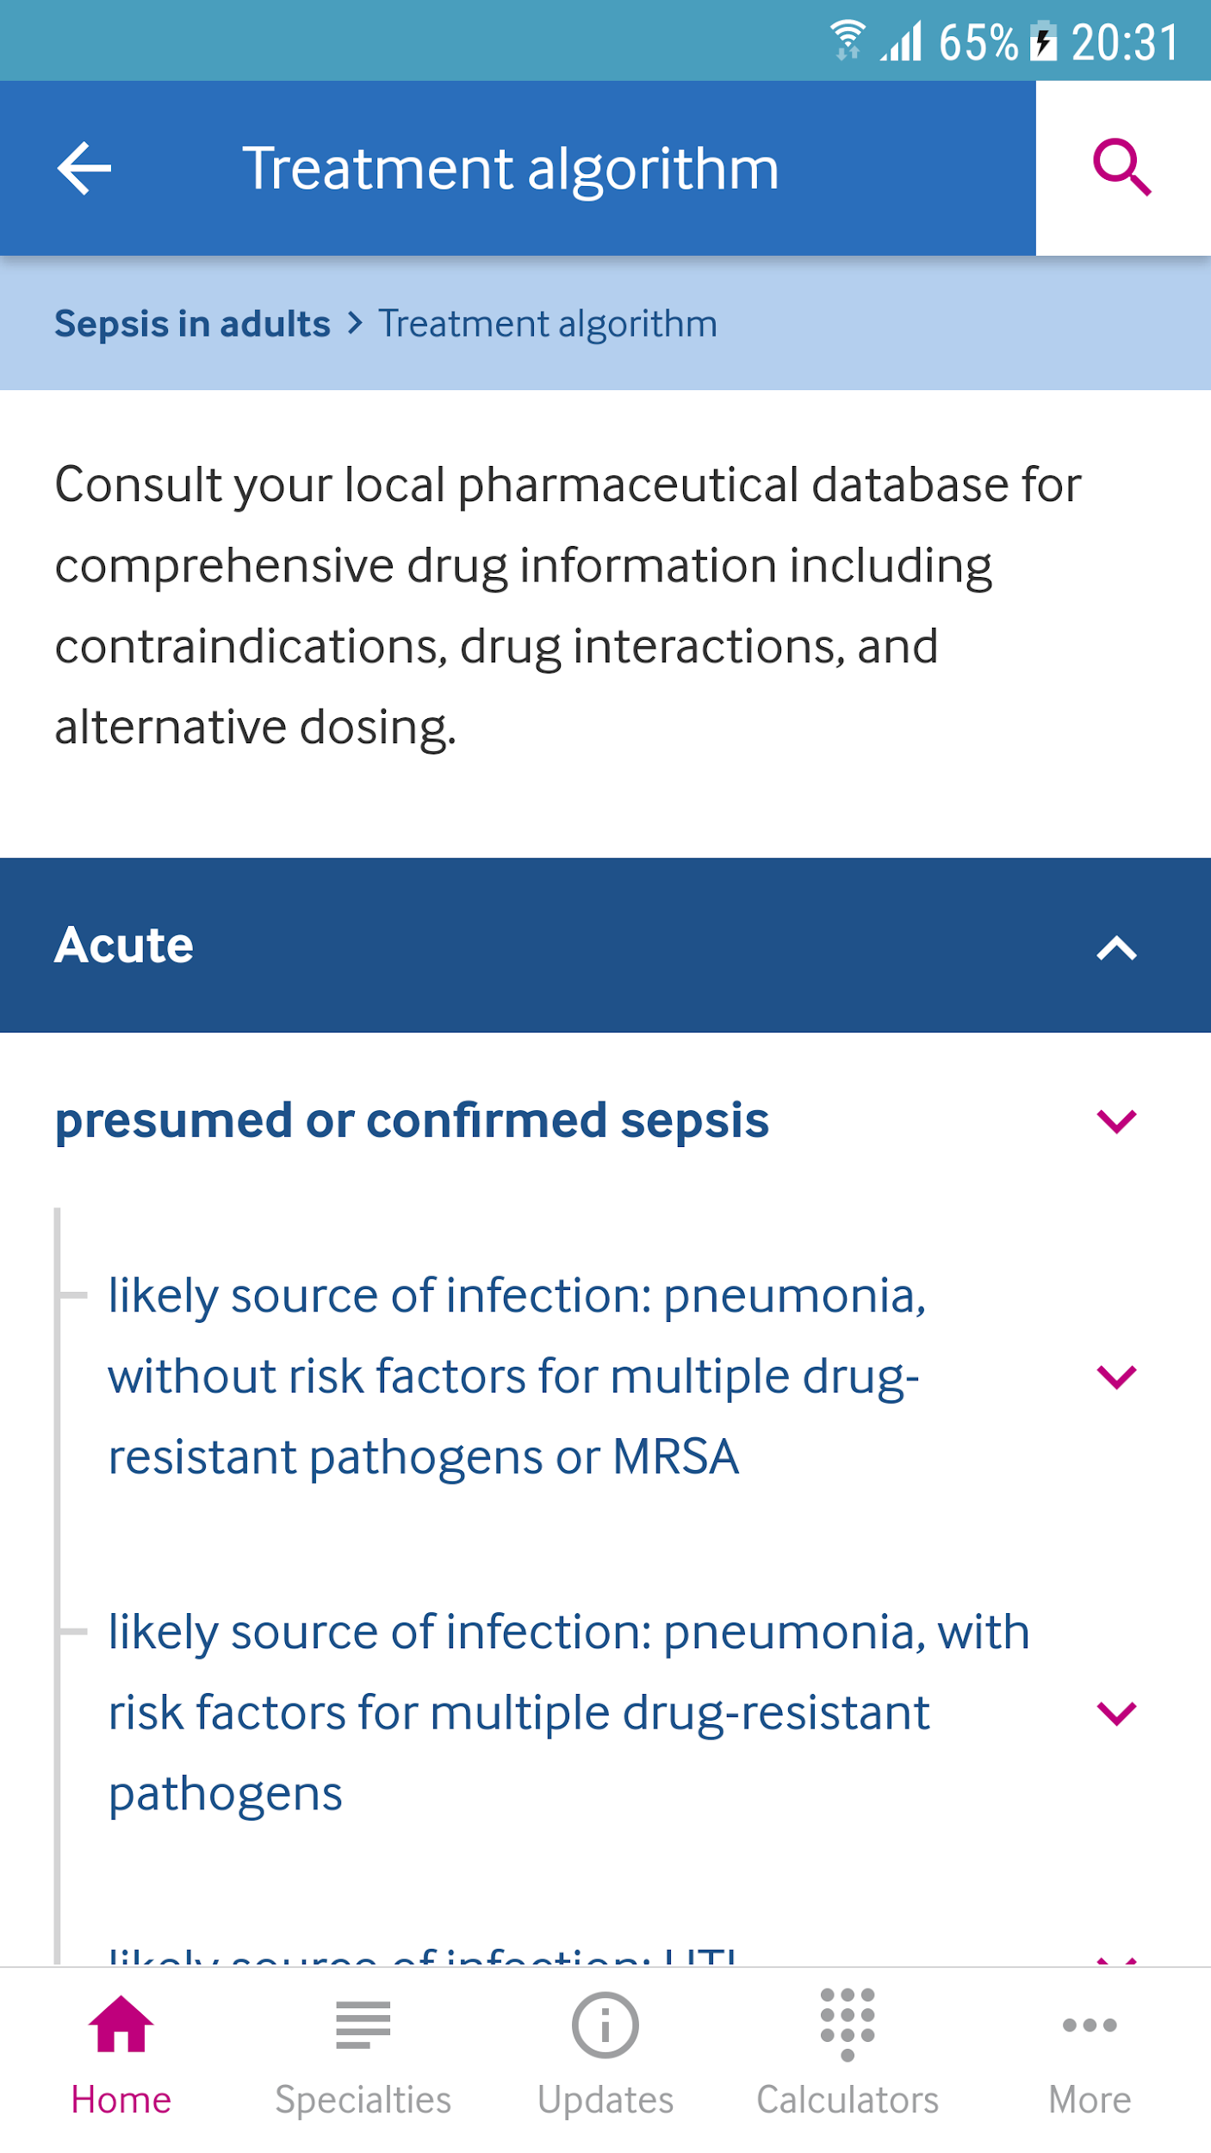
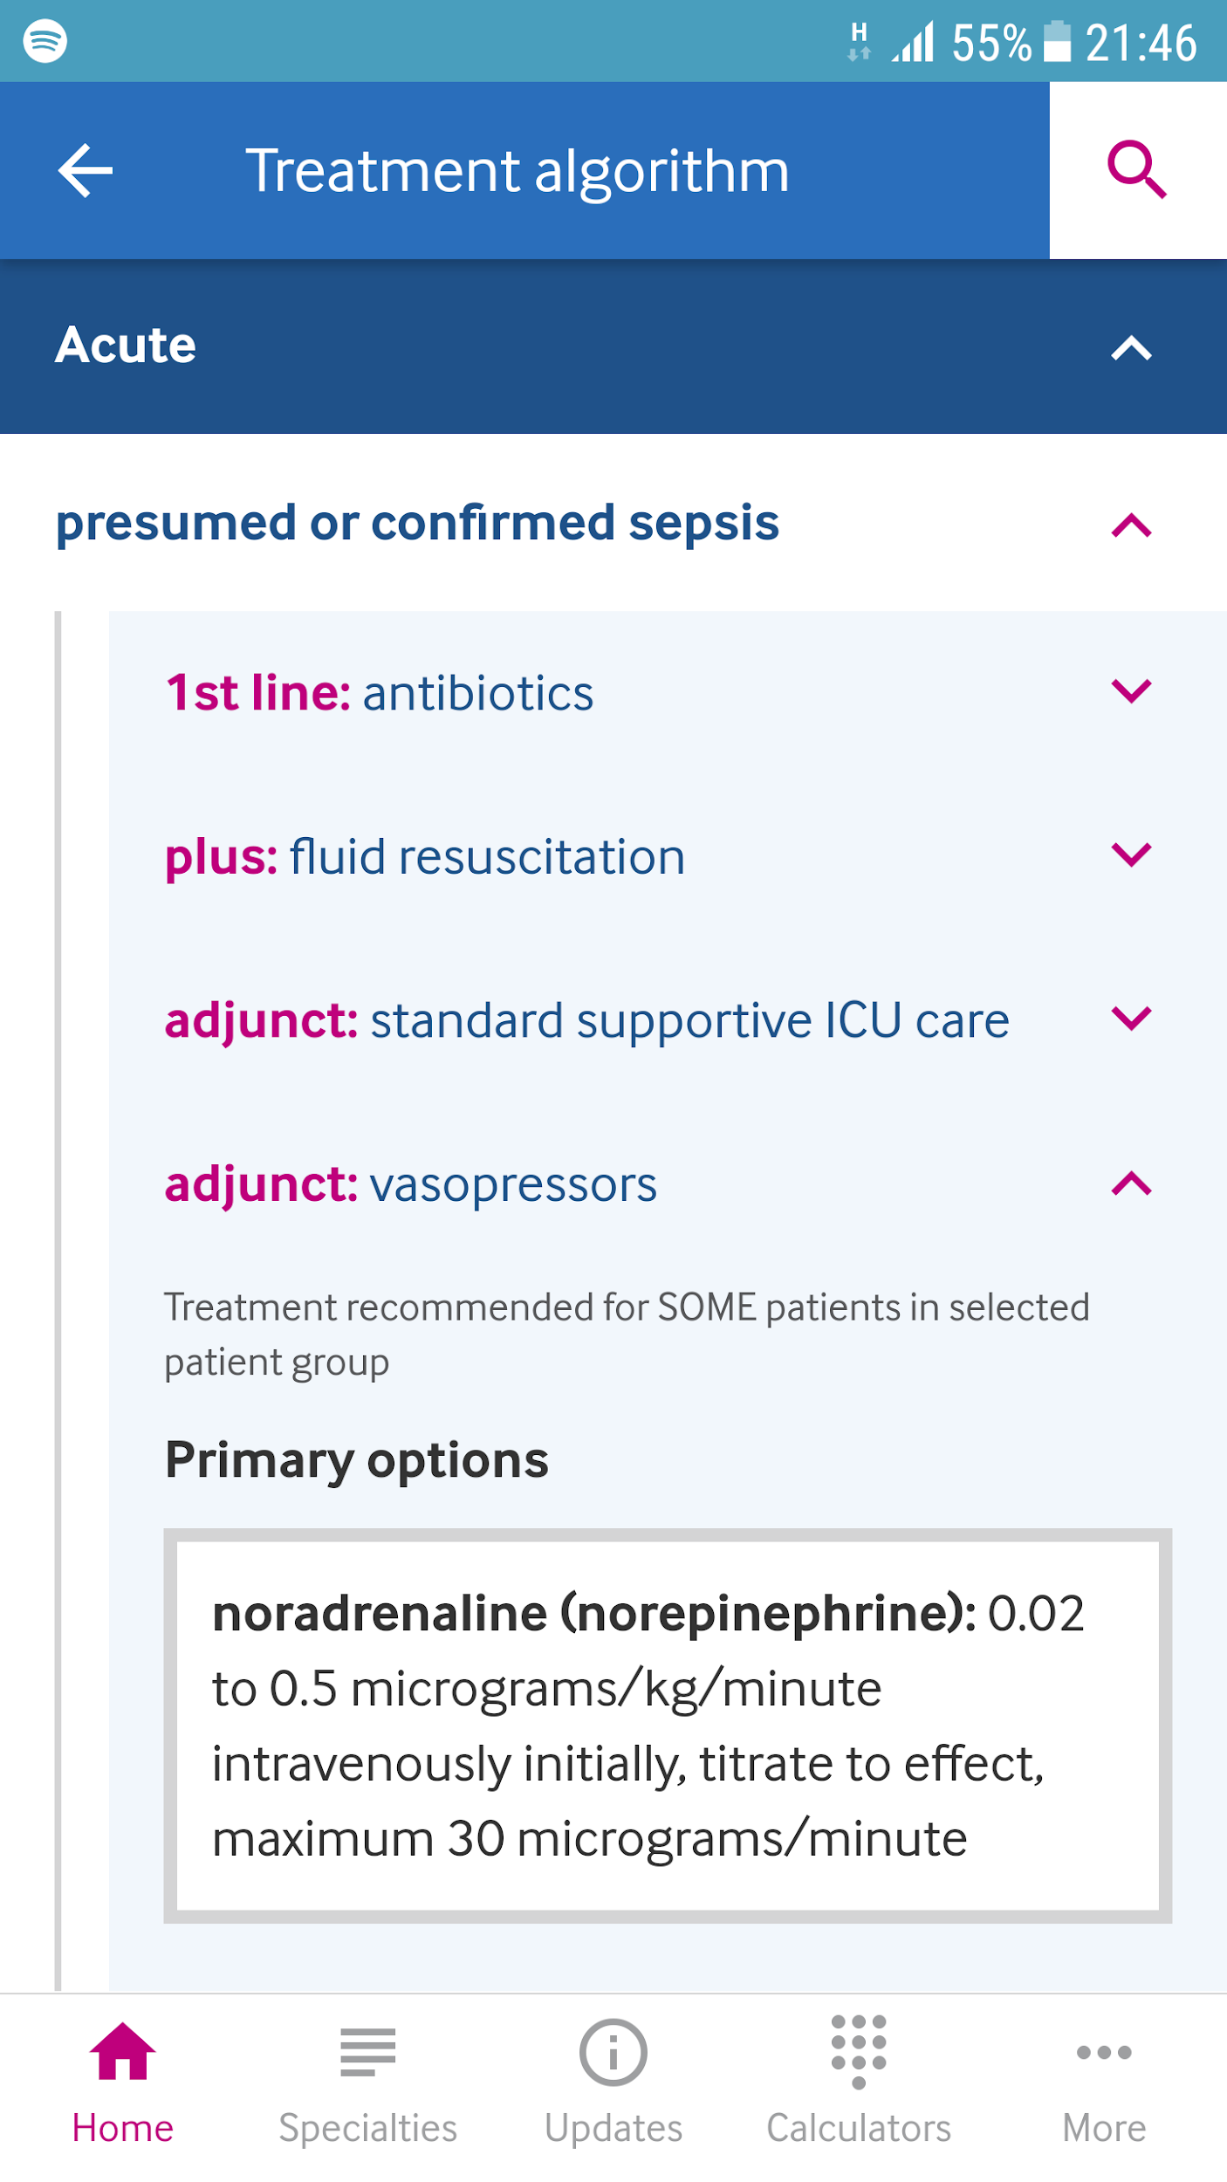
Using the BMJ Best Practice app
Notes:
You’ll notice that topics on the app have a very intuitive vertical navigation.

Slide 23
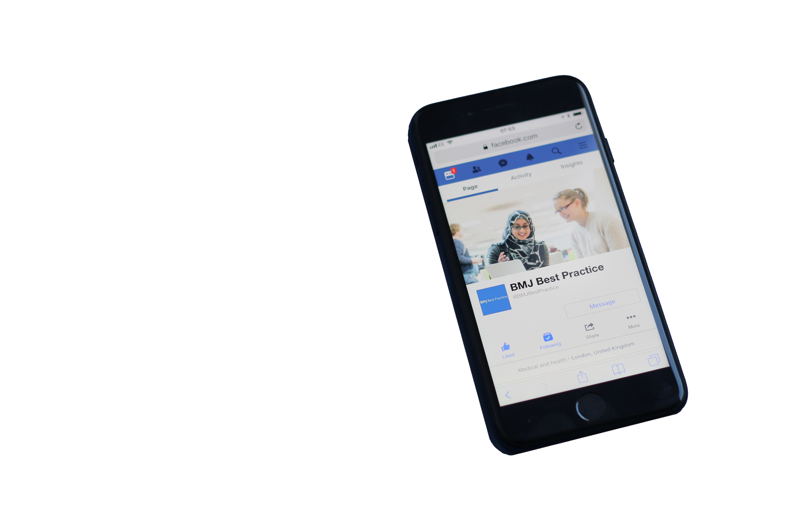
Never miss an update!
Follow us on social media
facebook.com/BMJBestPractice
@BMJBestPractice
Notes:
Best Practice is active on social media. You can expect to see engaging posts about diagnosis and management of conditions, as well as new topics or important updates.

Slide 24
Thank you!
bestpractice.bmj.com I training@bmj.com

Slide 25
For Primary Care replace slide 4 with the following slides

Slide 26
With extensive coverage of the most commonly-occurring conditions, BMJ Best Practice can be relied on to:
Support you with the very latest evidence and expert opinion, updated daily, and linked to international guidelines
“I find BP to be the most useful of all electronic clinical tools, it is logical and user friendly. I have BP & BNF open in my browser during most consultations and refer them frequently to ensure that my practice is in line with current thinking.”
Dr R. O'Shea, GP, UK
Provide detailed drug information on dosing, availability, formulations, side effects and contraindications with our integrated formularies
Help you discuss treatment options with patients. Best Practice has over 400 patient leaﬂets accredited by the Information Standard and reviewed by our Patient Panel
Provide access whether in the clinic, at home, or on call, with online, mobile and offline access via an app
Notes:
BMJ Best Practice can help ensure better, safer care with fast access to the latest clinical information.
Best Practice is used by the whole multidisciplinary team. So while it’s ideal for supporting new staff such as junior doctors, it is also used by nurses, and pharmacists. Why? Best Practice has the latest point of care information for over 90% of the most commonly presented conditions in both primary and secondary care settings.
Best Practice supports you with the very latest evidence and expert opinion.
Best Practice offers direct access to drug monographs on BNF/BNFC, without disturbing your workflow.
Best Practice also makes joint decision making easier, with access to over 400 patient leaflets.
The highly rated BMJ Best practice app is also available to you. This can be used offline, providing you with trusted decision support information in an instant.

Slide 27
Accredited by RCGP, BMJ Best Practice supports your professional development
automatic CME/CPD tracking to support revalidation and appraisals
“BMJ Best Practice is a trusted information source ideal for GPs, GP trainees and other healthcare professionals working in the primary care frontline."
Royal College of General Practitioners Assessor Panel
Notes:
Also, as long as you’re in logged into your personal account, or using the app – all search and browse activity is automatically tracked. You can then download CPD/CME certificates of your activity to support revalidation and appraisals

